Slide 1
Federation-less-federation of Network-virtualization Platforms
Yasusi Kanada, Toshiaki Tarui, and Kei Shiraishi
Hitachi, Ltd.
Notes:
1

Slide 2


Introduction
We are developing VNode and VNode Platform in a collaborative project.
VNode is a deeply-programmable
physical node with network-virtualization function.
Deeply-programmable: packet data processing, such as new non-IP protocol processing, can be programmable.
VNode Platform is a virtualization platform, which enables concurrent creation and use of multiple slices (virtual networks).

Slide 3
Research Goals
Our research goals are federation among two or more virtualization platforms including the VNode Platform.
Final goal: Heterogenious federation
  To federate new VNode Platform and several other platforms including ProtoGENI (developed in GENI Project in US).
First goal: Homogenious federation of VNode Platforms
  [Subgoal 1] To federate two or more previously-developed VNode Platforms.
    These platforms does not have federation functions.
    We intended to develop federation functions without additional development in the management system.
  [Subgoal 2] To enable Non-IP data communication on a cross-domain slice.

Slide 4
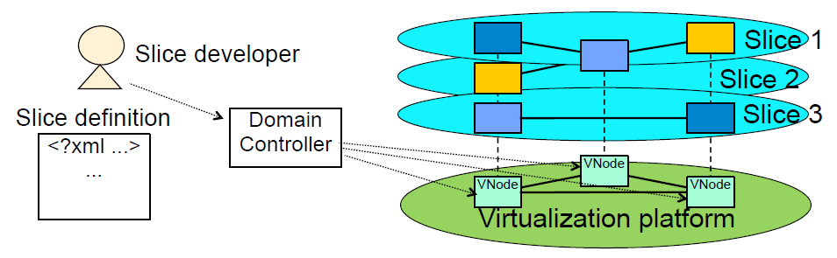
VNode Platform and VNode
In this platform (or architecture), multiple slices can be created on one physical network.
VNode (virtualization node) is a component of the VNode platform.
  VNode is a physical node.
  VNode forwards packets on the platform as a router.
  Slices are implemented as overlay networks on the IP network.
  VNodes are connected by tunnels using GRE/IP.
    GRE (Generic Routing Encapsulation) is a protocol standardized by IETF.
Slice specification
(management system)
(IP network)

Slide 5
Slice Creation and Management in the VNode Platform
The developer describes a slice specification.
  It specifies virtual nodes, virtual links, and binds between them.
  It is described by using an XML-based language.
  A slice is created by sending a slice specification to the domain controller (DC) of the VNode Platform.
  Other management operations, such as slice modification or deletion, is performed by using the same method.
Slice specification
Virtualization
platform
(domain)
Operation
(creation, modification,
deletion, etc.)
Domain controller
Slice S
(management system)
… N1
… N2
… N3
VN1
VL13
VL12
VN2
VN1
VNode N4
VNode N1
VL23
VN3
VL13
VNode N2
VL12
VNode N3
(in XML)
VN2
VN3
VL23

Slide 6
Federation between Virtualization Platforms
Three categories of federation functions:
  Resource discovery functions
  Slice handling functions
  Queries on statistics and manifests
In this paper/presentation, we focus on slice handling functions, especially, slice creation.
Slice handling functions
  Functions to create and to manage a slice that spread among multiple virtualization platforms from a single platform.

Slide 7
Federation between Virtualization Platforms (cont’d)
Basic federation method
  Instead of submitting the slice specification to both domains at once,
  it is passed to one domain and then passed to the other domain using the federation API.
More complicated messaging pattern
Slice specification
Domain A
Domain B
Slice S
Federation API
(Slice Exchange Point, SEP)
… N11
… N12
… N21
… N22
Operation
(creation, modification, etc.)
Domain Controller
Domain Controller
VN1
VL14
VN2
VL23
VNode N11
VN1
VL14
VL23
VN3
VNode N21
VN3
VNode
VNode N12
VNode N22
VNode
VN4
VN2
VN4
Federation API
Domain B
Slice specification
Domain A
Federation API
Federation API
Domain C
Domain D

Slide 8
Conceptual Outline of Federation-less Federation
A virtualization platform without federation functions does not have a concept of “other domain”.
  The “own domain” is the only domain, or there is no “domain” concept.
The other-domain-part of the slice must belong to the own domain (for the DC).
  This means that the other domain is a sub-domain of the own domain.
  Information in the other-domain-part must be hidden
  from the DC in the original domain.
    Because this part is to be managed only by the DC
    in the other domain.
    Duplicated management of this part must be avoided.
Slice S
Own domain
… N11
… N12
… N21
… N22
VN1
VN2
Other domain
VN3
VN4

Slide 9
Conceptual Outline of Federation-less Federation (cont’d)
PVN and DPN concepts
  In VNode Platform, the only way to express a sub-domain is to use a virtual node, which is called
  a pseudo virtual node (PVN).
  PVNs belong to a pseudo VNode called
  a domain proxy node (DPN)
Management of DPN and PVN
  DC can manage a DPN in the same
  way as a normal VNode.
  DC maps a PVN to a DPN by using
  the same way as a normal virtual node.
Slice specification
Slice S
VNode N11
VN1
VN2
VNode N12
PVN
VN3
DPN
(a pseudo VNode)
VN4

Slide 10
Conceptual Outline of Federation-less Federation (cont’d)
DPN conceptually contains an image of the other domain.
  PVN must contain the domain-B-part of the slice specification as a sub­structure.
Domain A
Domain B
Domain proxy node (Subdomain)
Domain proxy node (Subdomain)
Federation
Image of the other domain
Image of own domain
Image of the other domain
Image of own domain

Slide 11
Three Physical Components for Federation-less Federation
Domain proxy node (DPN)
  It receives a specification of PVN that contains the other-domain-part of slice definition and sends it to Gatekeeper.
Gatekeeper
  It receives the other-domain-part of slice definition and sends it to the other domain through the Federation API.
Gateway
  It converts the data packet from intra-domain format to inter-domain format.
The numbers of DPN,
gatekeeper, and gateway
may be the same or
different in federation of
three or more domains.
Domain D1
Domain D2
Domain controller
Gate-keeper 1
Gate-keeper 2
Common API
Federation API
(control plane)
Domain proxy node P11
VNode N11
Gate-way 1
Gate-way 2
VNode
VNode N12
Data exchange
(data plane)

Slide 12
Homogenious Federation
Process 1: Sender side
[Slice] In a slice specification given to DC 1,
PVN encloses the other-domain-part of the slice.
  The spec is in a domain-dependent form.
[Step 2] DC 1 sends the spec to DPN, as well as normal VNodes, using the same API.
[Step 3, 4] DPN sends the spec to the other domain through Gatekeeper 1.
  Gatekeeper 1 translates the spec into a domain-independent form.
Slice specification S1 (domain dependent form)
Domain independent form
Slice S
(1)
Domain D1
Domain D2
VN1*
… N11**
… N12**
… N21**
… N22**
… P11†
(4)
Operation
(creation, modification,
etc.)
DC 1
Gate-keeper 1
Gate-keeper 2
DC 2
VL14 ††
VN2*
VL23 ††
Common API
(2)
(3)
Federation API
Common API
VirtualNode PV1*
VN3*
Domain Proxy Node P11
Domain Proxy Node P21
VNode N11
VNode N21
VN4*
VNode
Gate-way 1
Gate-way 2
VNode N12
VNode N22
VNode
Data exchange protocol
(GRE，VLAN-based tunneling, etc.)

Slide 13
Homogenious Federation
Process 2: Receiver side
[Step 5] Gatekeeper 2 sends the spec to the DC.
  Gatekeeper 2 translates the spec to domain-dependent form.
[Step 6] DC 2 sends the spec to the DPN, as well as normal VNodes, using the same API.
The spec is processed in the same method as in the sender side except Gatekeeper 2 does not send it to the sender side.
  Gatekeepers tracks the state.
Slice specification S2 (domain dependent form)
Domain D1
Domain D2
Slice S
Domain controller
Gate-keeper 1
×
Gate-keeper 2
(5)
Domain controller
Operation
(creation, modification,
etc.)
VirtualNode PV2*
… N11**
… N12**
… P21†
… N21**
… N22**
(8)
VN1*
Common API
Federation API
(7)
(6)
Common API
VN2*
Domain proxy node P11
GCI‡
GCI‡
Domain proxy node P21
VNode N11
VNode N21
VL23 ††
VN3*
Gate-way 1
Gate-way 2
VL14††
VNode
VNode N12
VNode N22
VNode
VN4*
Data exchange protocol
(GRE，VLAN-based tunneling, etc.)

Slide 14
Homogenious federation: Notes
This method can also be applied to heterogenious federations.
  Either sender-side or receiver-side can be a different platform.

Slide 15
Message Loop Avoidance
Inter-domain messages may cause an infinite loop because the conceptual structure is recursive.
  There may be many recursion patterns when there are three or more domains.
An Infinite loop must be avoided by using message identification and/or marking.
Domain A
Domain B
Domain proxy node (Subdomain)
Federation
Domain proxy node (Subdomain)
Image of the other domain
Image of own domain
Image of the other domain
Image of own domain
Domain Controller (DC)
Domain D1
Domain D2
Domain Controller (DC)
Gate Keeper (GK)
Gate Keeper (GK)
Domain Proxy Node P11
Domain Proxy Node P21

Slide 16
Manageable Inter-domain Links for Non-IP Communication [Subgoal 2]
A link that corresponds to each inter-domain virtual link is created by stitching three sections.
  The inter-domain section is created through the gateway control interface (GCI) while inter-domain messaging.
  The intra-domain sections are created in the same method as normal virtual links in a domain.
The gateways may convert inter- and intra-domain protocols if necessary.
  E.g., In the current VNode Platform,
  GRE is used for intra-domain, VLAN is used for inter-domain.
Node N12
DPN P11
Gate-keeper 1
Federation API
Gate-keeper 2
DPN P21
Node N22
Gateway Control Interface (GCI)
Gateway Control Interface (GCI)
Gateway 1
Gateway 2
VN1
conv
conv
VN4
IP
VL14i1
IP
MAC
VL14e
MAC
IP
VL14i2
IP
Domain D1
Cross-domain network
Domain D2

Slide 17
Issues in Federation-less-Federation Method
Restriction on modification
  If the domain does not have an operation to update a virtual node, there is no way to update the structure of the other domain.
Difficulty in collecting information
  Resource discovery, statistical query, and asking manifests* may be difficult to implement because DC does not collect information of the other domain.
  *manifests: virtual-node host-names or addresses, etc.

Slide 18
Implementation and Evaluation*
An example of slice specification used for the evaluation is shown.
  Slice specification given to
  domain 1
    XML text
    Diagram
  Slice specification generated
  for domain 2

Slide 19
Implementation and Evaluation (cont’d)*
The sequence and measured time is as follows.

Slide 20
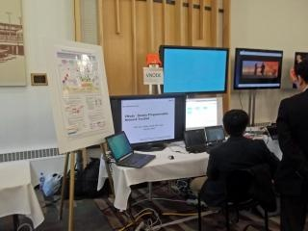
Conclusion
This paper proposes a method of federation between domains without a federation function.
The proposed method enables non-IP data communication on the slice.
This federation method was successfully implemented on the VNode Platform.
Future work includes heterogeneous federation, especially federation between VNode Platform and ProtoGENI.
  A limited implementation has been
  already demonstrated in GEC 16
  (i.e., 16th GENI Engineering Conference).

